Slide 1




PROJECT EVALUATION
AS AN INTERN DATA ANALYST

Slide 2


VIZUAMATIX
Welcome To
My Workspace
This is a Summery of My joureny as a Data Analyst in Prestigous Company Vizamatrix in First three months
Working in a supportive & friendly environment is a greatest privilage of mine
Hi There....
I am Pandula

Slide 3


VIZUAMATIX
Data Analyst
What is Special
in Vizuamatrix
As an intern at Vizuamatix, I was exposed to a wide range of new experiences and a new technology stack.
Another one of my accomplishments is that I've had the opportunity to work with more senior Supervisors.

Slide 4


VIZUAMATIX
Different
Innovative &
Creative Solutions
in Data Representation
OCR Table Extraction Project
01
ECL Financial Introduction
Session
02
FRMS Project Continuation
03
Computer Vision Demo Project Implementation
04

Slide 5


VIZUAMATIX
Good products always have good markets income
1) OCR Table Extraction Project
Table
Extraction
+
Accuracy Rate
<90%
Using Camelot library & pypdf2 to extract tables from given pdf with high accuracy rate fo company purposes

Slide 6
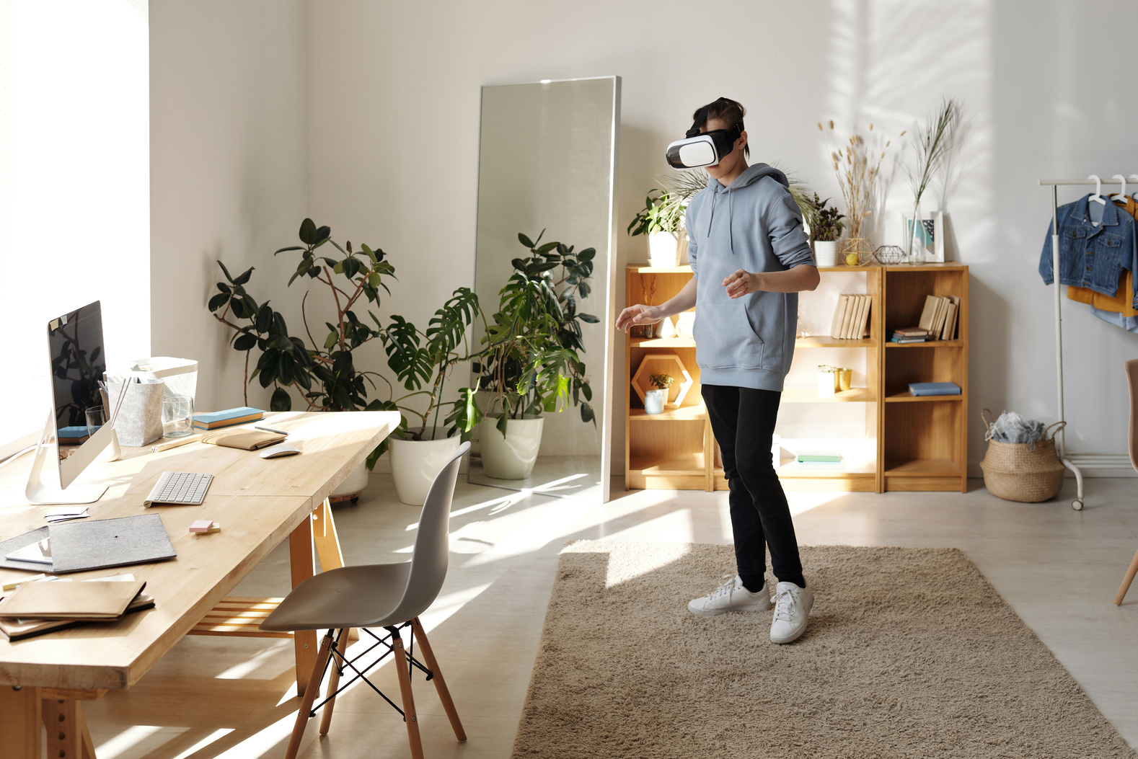

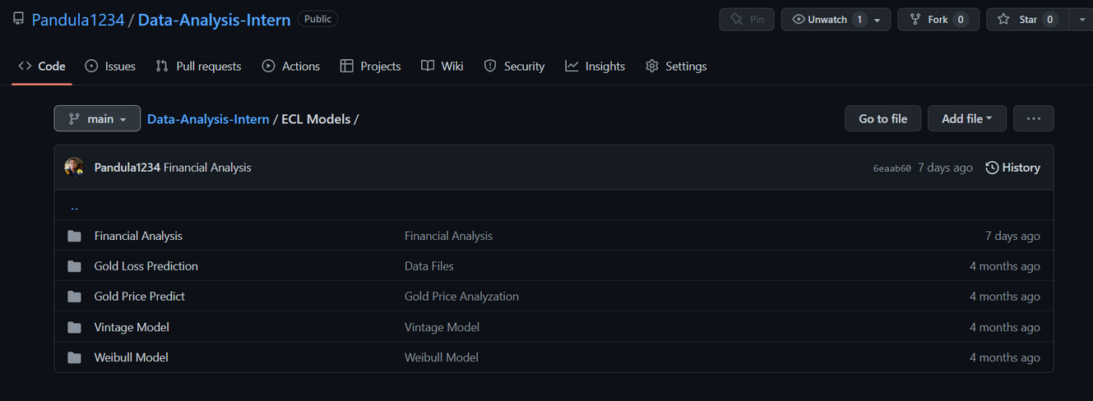

VIZUAMATIX
2) ECL Introduction Session and Model Building
Financial
Model Building
In ECL Project with collaboration of our company partner KPMG, We have implemented financial Models in Python
+

Slide 7

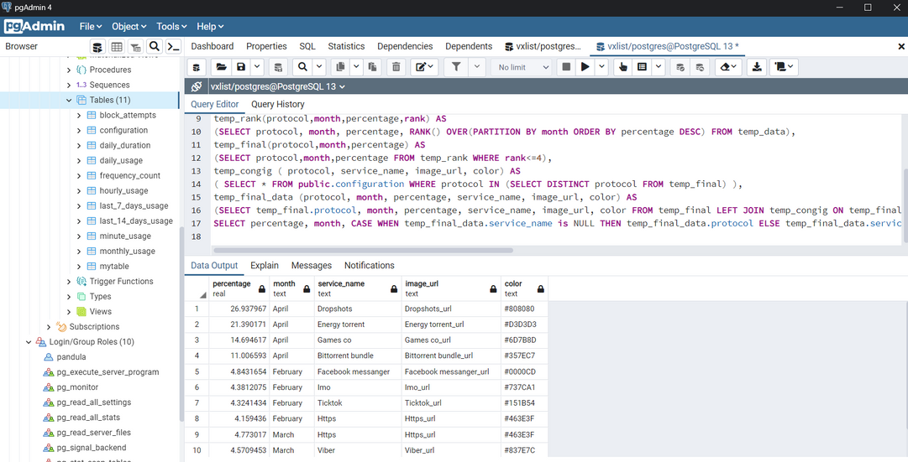
VIZUAMATIX
3) Database Query implementation for HUTCH Dashboard
Database
Database Query optimization is a very important aspect in software implementatio
Manipulation
Subscriber Home Page Queries
100%
With my knowledge in postgresql and SQL queries, I am being able to develop and solve query problems in
+

Slide 8

VIZUAMATIX
Good products always have good markets income
Data Analysis Work
What I
+
Gain from the Work
01
02
03
Learn New Concepts in Data Science
Image Processing Concepts
New Statistical Concepts

Slide 9




VIZUAMATIX
FUTURE PROGRESS
Improve Skills in Deep Learning and Neural Networks
On my Internship period i am hoping to polish my knowledge and skills in Data Science
Computer Vision based Solutions & Financial Sector related Solutions
Natural Language Processing based enhancements

Slide 10

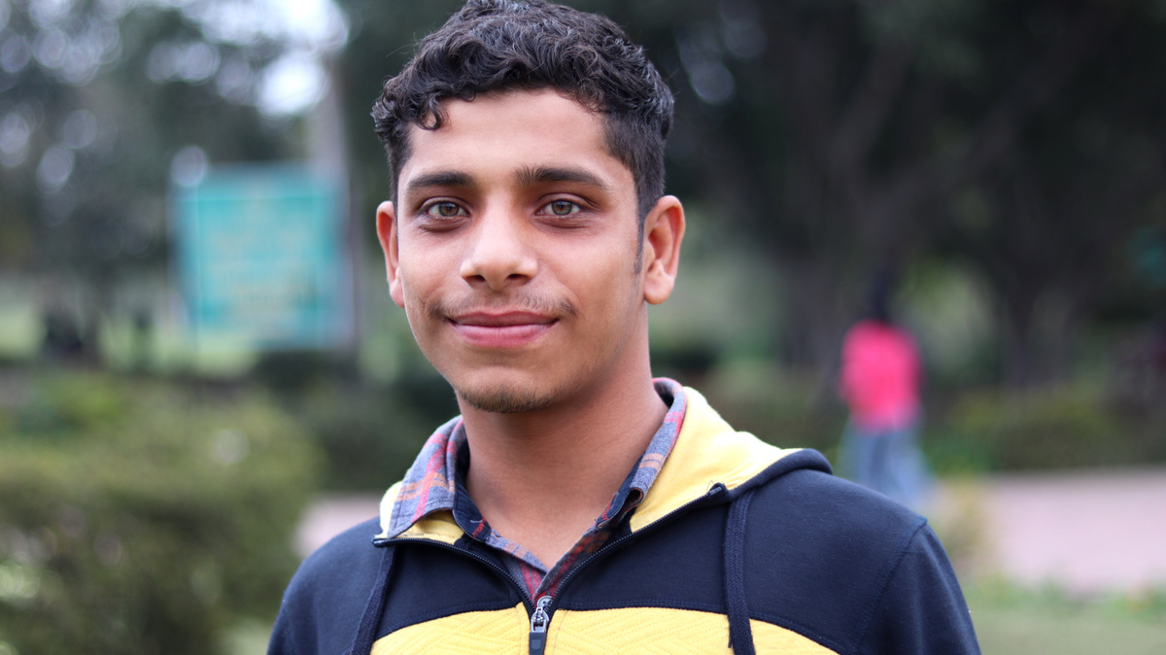


VIZUAMATIX
+
+
+
Creative
Thilina
Ravinath
Nethmi
team
DA Intern
DA Intern
Associative DA

Slide 11
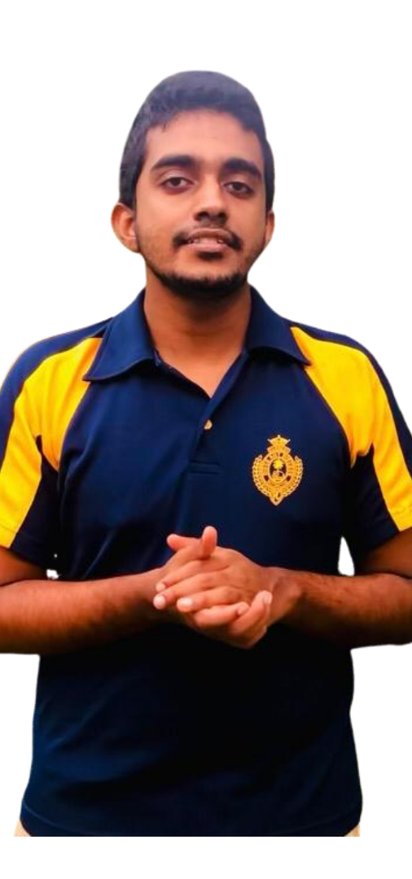
VIZUAMATIX
01
Dedication
My Commitments
In Here
02
Commitment
90%
95%
95%
Working with New Concepts and Technologies
Working in Virtual Environment with Office Atmosphere
Engage with the Collegues and Supervisors

Slide 12
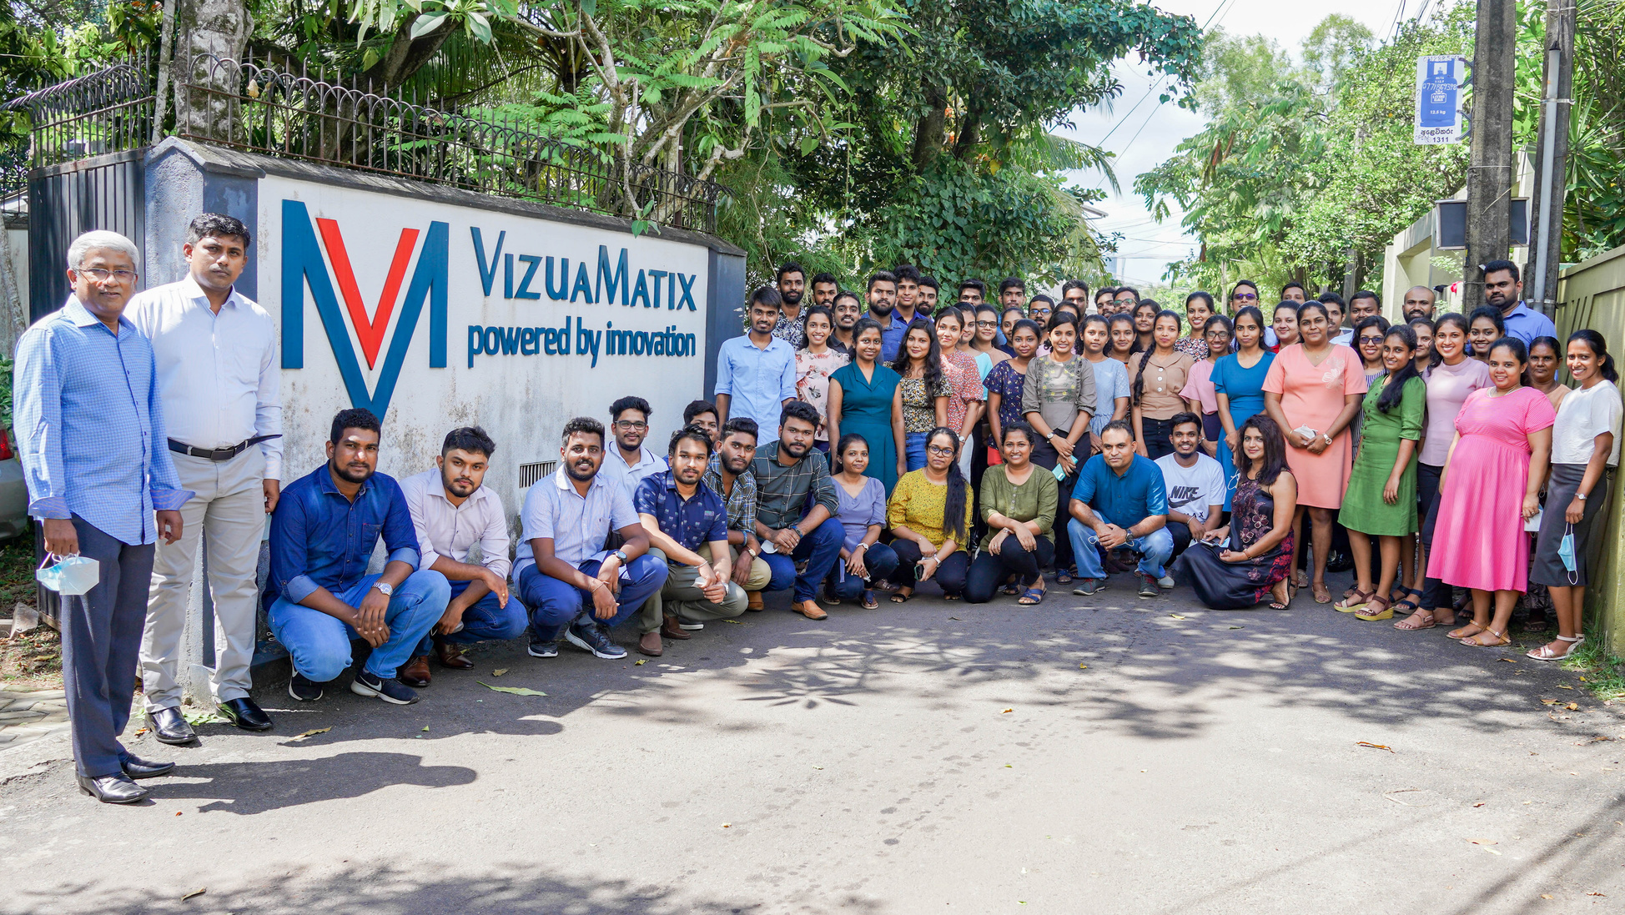
Steps of
creative process
VIZUAMATIX

Slide 13
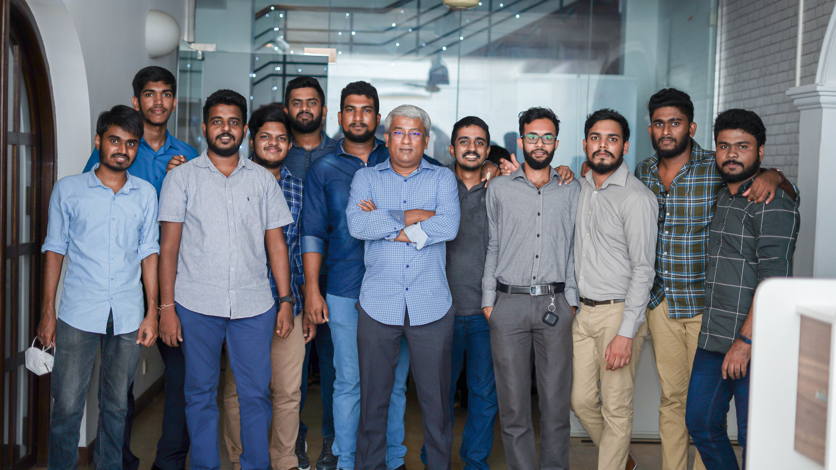




VIZUAMATIX
Thank you
0715979070
pandula@tsdclanka.com
http://panduinspire.home.blog
60, School Lane, Nawala, Colombo, Sri Lanka

